Slide 1
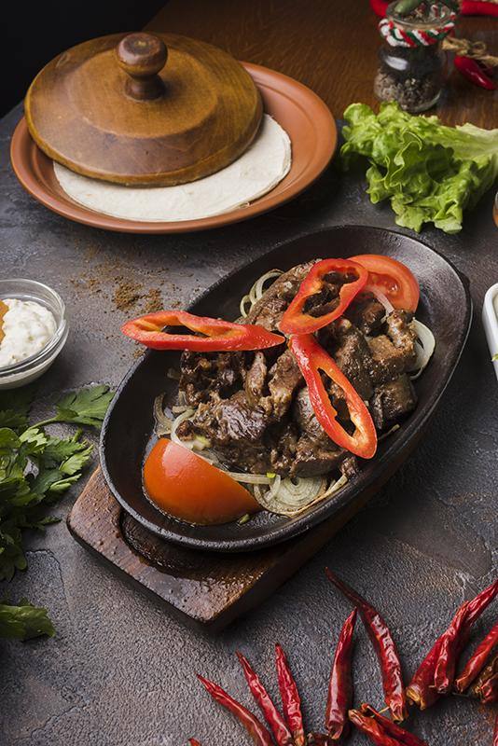
RESTAURANT MANAGEMENT SYSTEM
CH. Akshaya 22WH1A0510
G. Sravani 23WH5A0501

Slide 2
DESCRIPTION
This is a Simple Restaurant Management System implemented in C.
The system allows user to manage a menu of food items, and perform administrative tasks such as adding, editing, and deleting food items. The system also includes features to display order summaries, manage a stack of orders for each table, and process orders from a queue.

Slide 3

FEATURES
01
02
Restaurant Login
Food Ordering
03
04
Billing System
Sales Management

Slide 4
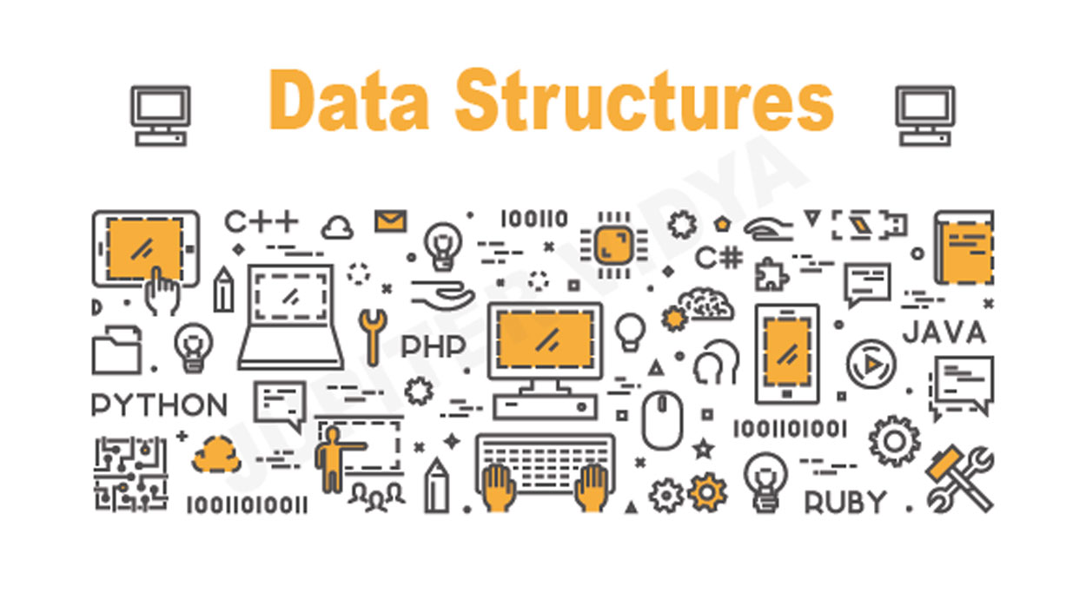
DATA STRUCTURES
1. Double Linked List
2. Queue
3. Stack
Insert your logo

Slide 5
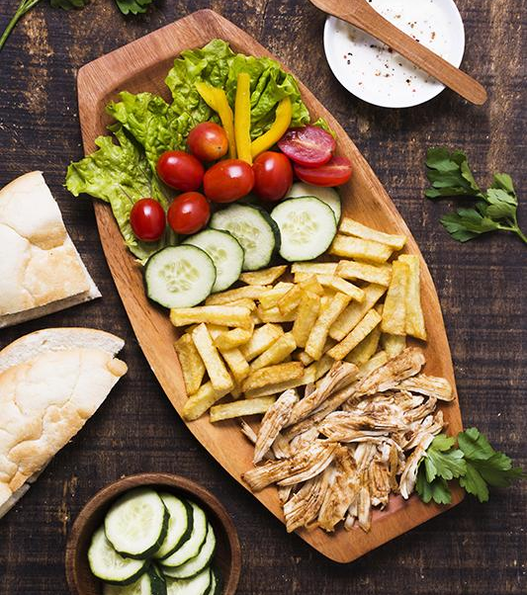
FEATURES
Display Menu
View the current menu of food items with details such as name, price and quantity.
Place Order
Customers can place orders by specifying their name, the item they want to order, and the quantity.
Admin Login
Authenticate as an admin to access additional features.

Slide 6

FEATURES
Display Order Queue
View the current orders in the queue, including customer names, item names, quantities, and prices.
Display Order Summary
View a summary of all placed orders, including total sales.
Bill Generation
Bill is generated with orders placed and total price to be paid.

Slide 7
THANK YOU

